Slide 1
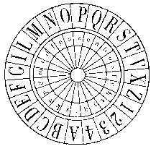
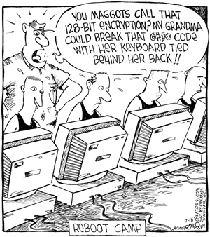
Classical Encryption Techniques (Chapter 2)
Dr. Arshad Farhad

Slide 2
Book Cipher
Traditionally book ciphers work by replacing words in the plaintext of a message with the location of words from the book being used. In this mode, book ciphers are more properly called codes.
This can have problems; if a word appears in the plaintext but not in the book, it cannot be encoded.
Possible solutions: Dictionary and Bible ciphers
An alternative approach which gets around this problem is to replace individual letters rather than words. (e.g., Beale cipher)

Slide 3
Beale Cipher
Book or text used for ciphering/deciphering: United States Declaration of Independence.
To decrypt writings of Beale, one finds the word corresponding to the number (e.g., the first number is 115, and the 115th word in the Declaration of Independence is "instituted")
Take the first letter of that word (in the case of the example, "I").
Note that this method of encryption is slightly different from a standard book cipher.
Notes:
From Wikipedia …
The Beale ciphers are a set of three ciphertexts, one of which allegedly states the location of a buried treasure of gold, silver and jewels estimated to be worth over USD$63 million as of September 2011. The other two ciphertexts allegedly describe the content of the treasure, and list the names of the treasure's owners' next of kin, respectively. The story of the three ciphertexts originates from an 1885 pamphlet detailing treasure being buried by a man named Thomas Jefferson Beale in a secret location in Bedford County, Virginia, in 1820. Beale entrusted the box containing the encrypted messages with a local innkeeper named Robert Morriss and then disappeared, never to be seen again. The innkeeper gave the three encrypted ciphertexts to a friend before he died. The friend then spent the next twenty years of his life trying to decode the messages, and was able to solve only one of them which gave details of the treasure buried and the general location of the treasure. He published all three ciphertexts in a pamphlet, although most of the originals were destroyed in a warehouse fire.

Slide 4
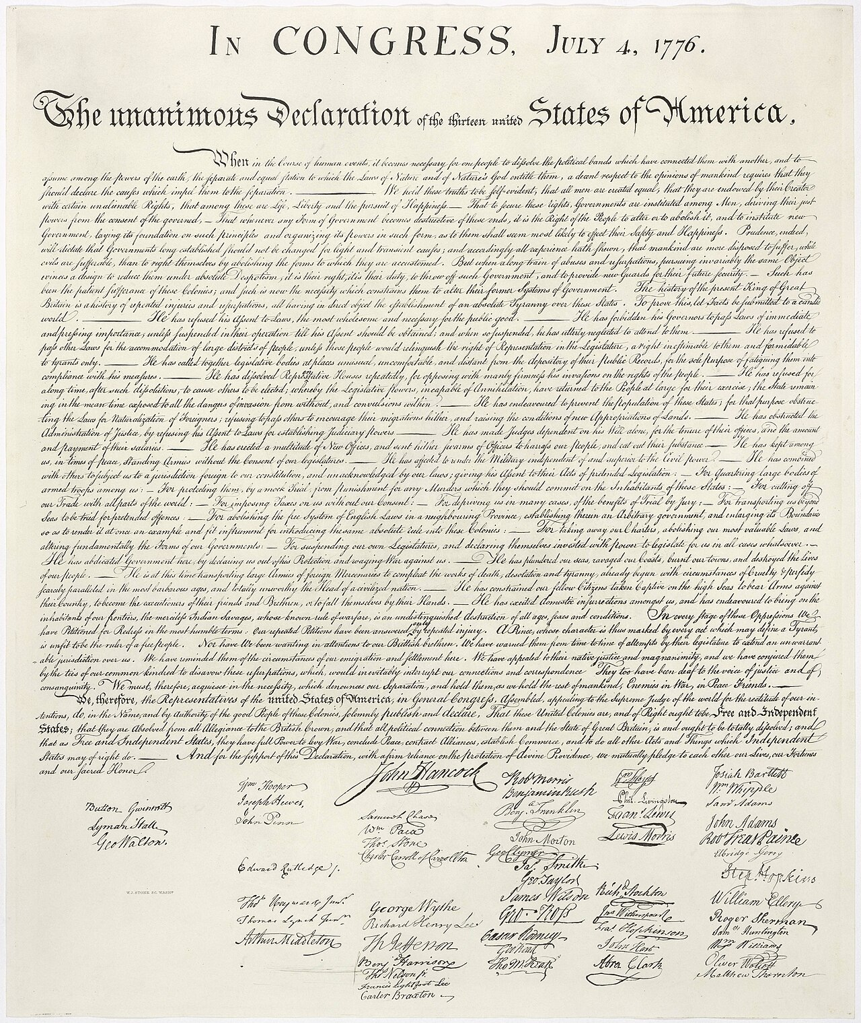

Slide 5
Classical Substitution Ciphers
Letters/bits of plaintext are replaced by other letters/bits.
Categorized as:
Monoalphabetic Ciphers – Simple Cipher
Homophonic Ciphers
Polyalphabetic Ciphers
Polygram Ciphers

Slide 6
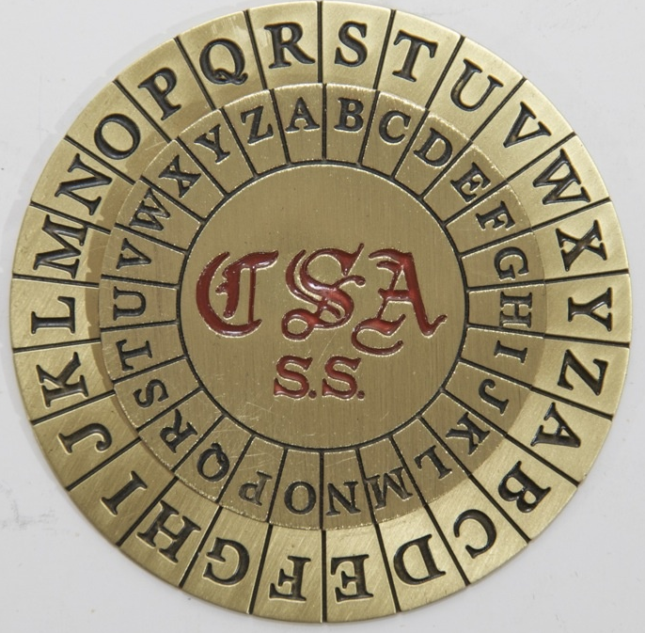
Poly alphabetic Ciphers
A plaintext letter maps to multiple ciphertext letters.
Multiple mono-alphabetic substitutions are applied through the plaintext.
A key defines which mono-alphabetic substitution to apply.

Slide 7
Polyalphabetic Ciphers
Polyalphabetic substitution ciphers were first described in 1467 by Leone Battista Alberti in the form of disks.
In a polyalphabetic cipher, multiple cipher alphabets are used. To facilitate encryption, all the alphabets are usually written out in a large table, usually 26×26.
The method of filling the table, and of choosing which alphabet to use next, defines the particular polyalphabetic cipher.

Slide 8
Polyalphabetic Ciphers
One of the most popular was that of Blaise de Vigenère. First published in 1585, it was considered unbreakable until 1863. (Commonly known by French as "indecipherable cipher").
The Gronsfeld cipher.
The Beaufort cipher.
The autokey cipher,
The running key cipher

Slide 9
Vigenere Cipher
Constitutes of 26 Caesar ciphers To encrypt n plaintext letters:
C_{i} = (p_{i} + k_{i}) mod 26; 1 ≤ i ≤ n
To decrypt n ciphertext letters:
p_{i} = (C_{i} - k_{i}) mod 26; 1 ≤ i ≤ n
The key is of length d, i.e., K = k₁ k₂ ... k_{d}
Use each key letter in turn.
Repeat from k₁ after d letters.

Slide 10
Vigenere Cipher (Encryption)
The key is "KEY,"
Repeat it to match the length of the plaintext.
Apply the Vigenère cipher formula: Ci = (pi + ki) mod 26 for each letter in the plaintext.
For the first letter 'H’:
(H + K)= (7 + 10) mod 26 = 17, corresponding to ‘R’ in the alphabet table.
For the second letter, 'E':
E + E = (4 + 4) mod 26 = 8, corresponding to 'I' in the alphabet table.
For 'L', 'L', and 'O', we repeat the process with the corresponding key letters.
'L' becomes 'J'
'L' becomes 'V'
'O' becomes 'S’
Ciphertext: "RIJVS.”

Slide 11
Vigenere Cipher (Decryption)
To decrypt the ciphertext back to the plaintext, use the same key and the decryption formula: pi = (Ci - ki) mod 26 for each letter in the ciphertext.
The key is still "KEY," and repeat it to match the length of the ciphertext, which is "RIJVS" to "KEYKE."
Apply the Vigenère decryption formula for each letter:
For the first letter 'R':
R (ciphertext) corresponds to 17 in the alphabet table.
K (the first letter of the key) corresponds to 10.
(17 - 10) mod 26 = 7, corresponding to ‘H’ in the alphabet table.
For the second letter, ‘I’:
I correspond to 8 in the alphabet table.
E (the second letter of the key) corresponds to 4.
(8 – 4) mod 26 = 4, corresponding to 'E' in the alphabet table.
Continue this process for the remaining letters using the corresponding key letters.
Combining all the shifted letters in the reverse direction gives us the original plaintext: "HELLO."

Slide 12
Example
Vigenere Cipher (Using Table)
K : deceptive
PT: we are discovered save yourself
K:
PT:
CT:
d | e | c | e | p | t | i | v | e | d | e | c | e | p | t | i | v | e | d | e | c | e | p | t | i | v | e
w | e | a | r | e | d | i | s | c | o | v | e | r | e | d | s | a | v | e | y | o | u | r | s | e | l | f
Z | I | C | V | T | W | Q | N | G | R | Z | G | V | T | W | A | V | Z | H | C | Q | Y | G | L | M | G | J

Slide 13
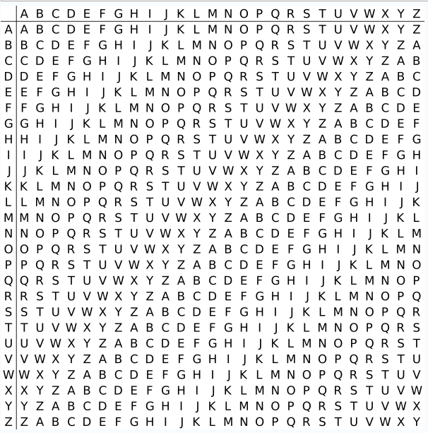
Example: Using the Vigenere Table
To encrypt:
Use k_{i} for row
Use p_{i} for column
C_{i} is the alphabet at the intersection.
To decrypt:
Use k_{i} for row.
Locate C_{i} in the row, p_{i} is the alphabet at the column top.
K : deceptive
PT: we are discovered save yourself
K:
PT:
CT:
d | e | c | e | p | t | i | v | e | d | e | c | e | p | t | i | v | e | d | e | c | e | p | t | i | v | e
w | e | a | r | e | d | i | s | c | o | v | e | r | e | d | s | a | v | e | y | o | u | r | s | e | l | f
Z | I | C | V | T | W | Q | N | G | R | Z | G | V | T | W | A | V | Z | H | C | Q | Y | G | L | M | G | J

Slide 14
Classical Substitution Ciphers
Letters/bits of plaintext are replaced by other letters/bits.
Categorized as:
Monoalphabetic Ciphers – Simple Cipher
Homophonic Ciphers
Polyalphabetic Ciphers
Polygram Ciphers

Slide 15
Polygram Ciphers
In a polygraphic substitution cipher, plaintext letters are substituted in larger groups, instead of substituting letters individually.
Encrypt multiple letters at a time.
The first advantage is that the frequency distribution is much flatter than that of individual letters
Second, the larger number of symbols requires correspondingly more ciphertext to productively analyze letter frequencies.
The Playfair Cipher is the best known such cipher. Widely used from 1860 to 1960.
Invented by Charles Wheatstone in 1854, but named after his friend Baron Playfair.
Notes:
Invented by Charles Wheatstone in 1854, but named after his friend Baron Playfair.

Slide 16
Playfair Key Matrix
Use a 5 x 5 matrix.
Fill in letters of the key (w/o duplicates).
Fill the rest of matrix with other letters.
E.g., key = MONARCHY.
M | O | N | A | R
C | H | Y | B | D
E | F | G | I/J | K
L | P | Q | S | T
U | V | W | X | Z
<number>
Notes:
<number>

Slide 17
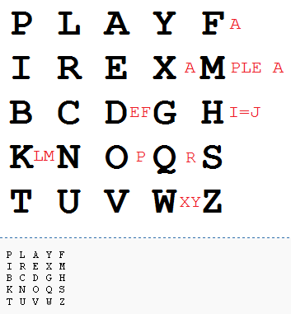
Example
http://en.wikipedia.org/wiki/Playfair_cipher
Key: playfair example

Slide 18
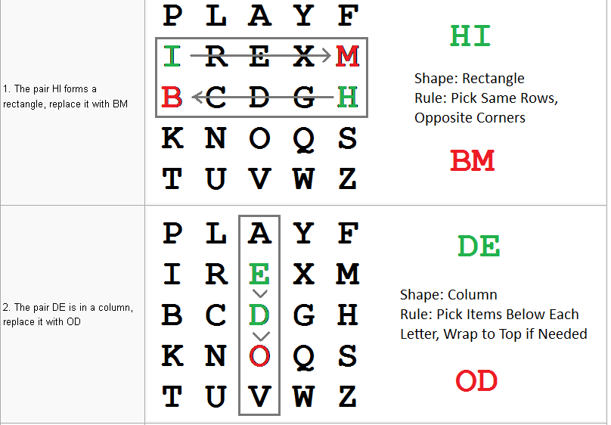
Message: Hide the gold in the tree stump
Digraph: HI DE TH EG OL DI NT HE TR EX ES TU MP

Slide 19
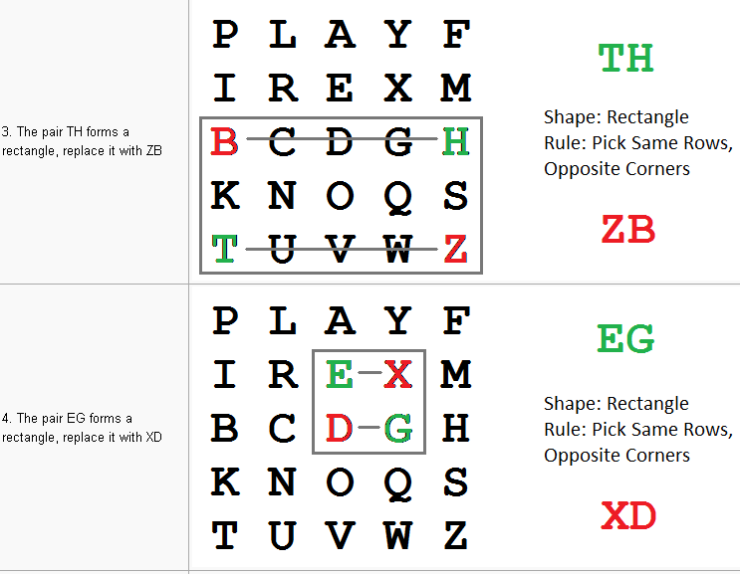

Slide 20
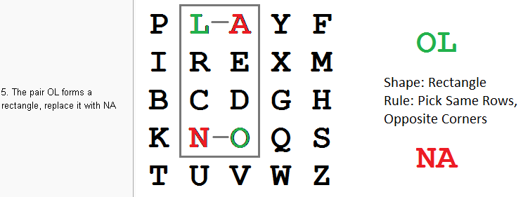
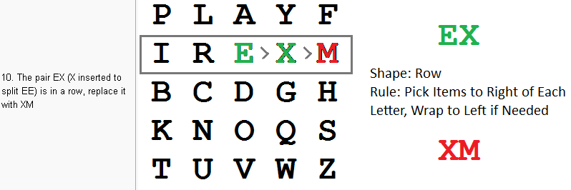
Encrypted Message: BMODZBXDNABEKUDMUIXMMOUVIF

Slide 21
Encrypting and Decrypting
Plaintext is encrypted two letters at a time.
If a pair is a repeated letter, insert filler like 'X’.
If both letters fall in the same row, replace each with the letter to its right (circularly).
If both letters fall in the same column, replace each with the the letter below it (circularly).
Otherwise, each letter is replaced by the letter in the same row but in the column of the other letter of the pair.
<number>
Notes:
<number>

Slide 22
Security of Playfair Cipher
Security is much improved over the simple monoalphabetic cipher.
Was widely used for many decades
eg. by US & British military in WW1 and early WW2
Once thought to be unbreakable.
<number>
Notes:
<number>

Slide 23
Classical Transposition Ciphers
Permutation of the plaintext letters.
Hide the message by rearranging the letter order without altering the actual letters used.
Rail Fence Cipher
Route cipher
Columnar Transposition Cipher
Grille

Slide 24
Rail Fence Cipher
Plaintext is written down as a sequence of diagonals and read off as a sequence of rows.
E.g. the PT: meet me after the party, is written using a rail fence of depth 2 as:
CT: MEMATRHTGPRYETEFETEOAAT
m |  | e |  | m |  | a |  | t |  | r |  | h |  | t |  | g |  | p |  | r |  | y
 | e |  | t |  | e |  | f |  | e |  | t |  | e |  | o |  | a |  | a |  | t

Slide 25
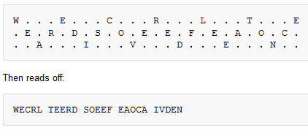
Rail Fence Cipher
Plain Text: WE ARE DISCOVERED. FLEE AT ONCE
http://en.wikipedia.org/wiki/Transposition_cipher

Slide 26
Route Cipher
In a route cipher, the plaintext is first written out in a grid of given dimensions, then read off in a pattern given in the key.
Route ciphers have many more keys than a rail fence. In fact, for messages of reasonable length, the number of possible keys is potentially too great to be enumerated even by modern machinery.
However, not all keys are equally good. Badly chosen routes will leave excessive chunks of plaintext, or text simply reversed, and this will give cryptanalysts a clue as to the routes.

Slide 27
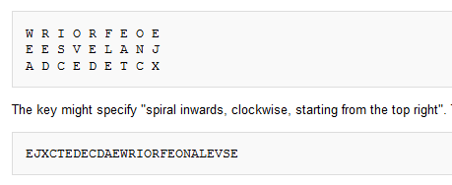
Route Cipher
http://en.wikipedia.org/wiki/Transposition_cipher

Slide 28
Columnar Transposition Cipher
In a columnar transposition, the message is written out in rows of a fixed length, and then read out again column by column, and the columns are chosen in some scrambled order.
Both the width of the rows and the permutation of the columns are usually defined by a keyword.
For example, the word ZEBRAS is of length 6 (so the columns are of length 6), and the permutation is defined by the alphabetical order of the letters in the keyword. In this case, the order would be "6 3 2 4 1 5"

Slide 29
Columnar Transposition Cipher
Write the message row-wise.
Read the message column-wise, in some specific order.
For example:
Plaintext: Attack Postponed until two am
Ciphertext: TTNAAPTMTSUOAODWCOIXKNLYPETZ
Key: 4312567 or DCABEFG
Column length is specified by first number in key.
4 | 3 | 1 | 2 | 5 | 6 | 7
a | t | t | a | c | k | p
o | s | t | p | o | n | e
d | u | n | t | i | l | t
w | o | a | m | x | y | z

Slide 30
Analysis of columnar transposition
Simple transposition can be easily detected by doing a frequency count.
Can be attacked by anagramming (rearranging).
Also keys very close to the correct key will reveal
Can be more secure if multiple stages of transposition, using multiple keys, are performed.
Double columnar transposition is more secure and is similar to single columnar transposition, but the process is repeated twice.

Slide 31
Practice
Columnar Cipher:
Plaintext: "ENCRYPT THIS MESSAGE"
Key: "CIPHER”
Route Cipher:
Plaintext: "MEET ME AFTER SCHOOL”
Key: spiral inwards, clockwise, starting from left top
Rail Fence Cipher:
Plaintext: "HELLO WORLD"
Number of Rails (Key): 3
Playfair Cipher:
Plaintext: "HELLO WORLD"
Key: "KEYWORD"

